Slide 1
SUPPLY CHAIN VISIBILITY SYSTEM WITH OPTIMIZATION ANALYTICS
INFOSYS SPRINGBOARD • VIRTUAL INTERNSHIP 7.0
Team Members: Uppala Bhavya Sri | V.Charita Sree Velpuri Sai Rohitha | Venkata Puneeth Kothapalli | Yuvasree P
Team D • Group 1 Mentor: Ms. Nityasree

Slide 2
- PROJECT OBJECTIVE
Project Modules:
Sales Performance Analysis
Delivery & Supply Chain Operations
Customer & Business Insights
Product & Category Performance
Geographic & Market Performance
Cost & Profitability Analysis
Order Value & Performance Insights
Analyze supply-chain data to understand sales, orders, customers, products, shipping, delivery, and profitability.
Identify important business and supply-chain performance patterns from transactional data.
Compare performance across customer segments, product categories, shipping modes, markets, and regions.
Develop interactive Power BI dashboards to provide meaningful insights for better decision-making.

Slide 3
- PROJECT EXECUTION MILESTONES
Milestone 1
Data Acquisition & Cleaning
Collected and imported the DataCo Supply Chain Dataset into Power BI and examined its structure, attributes, and data quality.
Used Power Query Editor to clean and transform the raw data through data-type correction, column removal, value replacement, column renaming/reordering, locale-based conversion, and validation.
Milestone 2 –
Data Modeling
Prepared the cleaned dataset for Power BI analysis by organizing the required fields and analytical attributes.
Developed the required calculations, measures, and KPIs for supply-chain performance analysis.
Milestone 3 – Development
Developed interactive Power BI dashboards covering sales, delivery, customers, products, geography, profitability, and order performance.
Used KPI cards, charts, tables, maps, scatter,treemaps, decomposition trees, and interactive filters to present business insights.
Milestone 4 – Review & Optimization
Reviewed the dashboard calculations, visuals, and analytical outputs for consistency.
Improved dashboard usability, readability, filtering, and presentation.
单击此处编辑母版文本样式
二级
三级
四级
五级

Slide 4
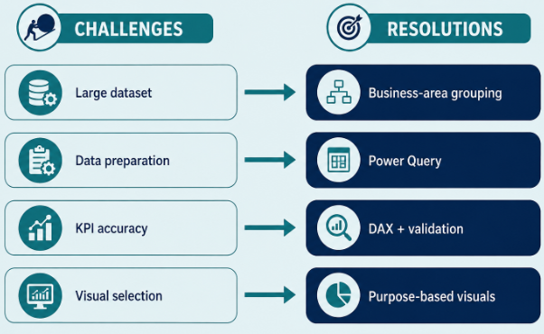
- CHALLENGES & RESOLUTIONS
Challenges
The dataset contains a large number of transactional records and multiple supply-chain attributes.
Raw data required cleaning and standardization before analysis.
Presenting multiple business dimensions in an interactive and understandable dashboard was challenging.
Resolutions
Used Power Query to efficiently clean, transform, and organize the dataset.
Corrected data types, removed unnecessary columns, standardized values, and validated important fields.
Used appropriate Power BI KPIs, visualizations, filters, and dashboard layouts to present the analysis clearly.

Slide 5
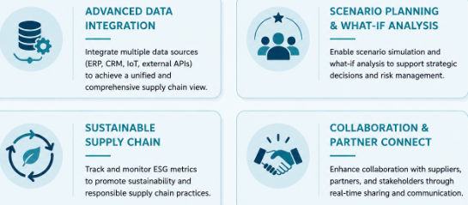
- FUTURE ENHANCEMENTS & KEY INSIGHTS
Future Enhancements
Integrate predictive analytics for delivery and supply-chain performance.
Add forecasting for sales, demand, and profitability.
Introduce optimization-based recommendations for shipping and operational planning.
Add more advanced drill-downs and automated decision-support features.
Key Insights
Supply-chain performance can be evaluated across sales, orders, customers, products, shipping, and geography.
Comparing actual and scheduled shipping performance helps identify delivery-related issues.
Analysis of sales, discounts, and profitability helps identify high-value and less-profitable business areas.

Slide 6
– CONCLUSION
Technical Skills
Microsoft Power BI
Power Query Editor
DAX & Data Modeling
Data Preprocessing
Data Visualization
Business Intelligence
GitHub / GitLab
Supply Chain Visibility and Optimization successfully transformed the DataCo Supply Chain Dataset into an interactive Power BI Business Intelligence solution, providing visibility into sales, orders, customers, products, shipping, delivery, geography, costs, discounts, and profitability.
The project progressed through data acquisition and preprocessing, data modeling, dashboard development, and analysis/optimization, resulting in meaningful business insights to support supply-chain monitoring and decision-making.
单击此处编辑母版文本样式
二级
三级
四级
五级
Soft Skills
Problem Solving
Analytical Thinking
Communication
Teamwork
Presentation
Time Management

Slide 7
ACKNOWLEDGEMENTS & REFERENCES
Acknowledgements
• Infosys Springboard – Virtual Internship 7.0
• Mentor – Ms. Nityasree
• Team D – Group 1
• Uppala Bhavya Sri
• V. Charita Sree
• Velpuri Sai Rohitha
• Venkata Puneeth Kothapalli
• Yuvasree P
单击此处编辑母版文本样式
二级
三级
四级
五级
References
• DataCoSupplyChainDataset
• Microsoft Power BI Documentation
• Power BI Community Resources
• Kaggle Dataset Resources
• Infosys Springboard Learning Materials
• Microsoft Power Query & DAX resources

Slide 8
THANK YOU

